Slide 1
Vidyavardhini’s College of Engineering & Technology
K.T. Marg, Vartak College Campus, Vasai Rd, Vasai-Virar, Maharashtra 401202
Department of Computer Science and Engineering [Data Science]
Loyalty Points Exchange System using Blockchain
Group No: 5
Saurabh Pandey 35
Sajid kassari 72
Harsh Tamore 74
Ms. Chaitali Mhatre
Date: 17/10/2024

Slide 2
Contents
Introduction
Problem Statement
Literature Survey
Proposed System
Architecture / Framework / Block diagram / Algorithm / Process Design
Details of Hardware / Software used
Output
Result Analysis
Conclusion
References

Slide 3
Introduction
The Loyalty Points Exchange System is a blockchain-based decentralized platform aimed at revolutionizing how loyalty points are managed. It addresses common challenges like transparency, interoperability, and security in loyalty programs.
Companies can issue loyalty points to users, while users can redeem or transfer these points within the system using smart contracts on the Ethereum blockchain. The project eliminates intermediaries, creating trust through decentralization

Slide 4
Problem statement
Transparency Issues: Difficulty in tracking points leads to distrust among users.
Interoperability Challenges: Limited point transfer between companies restricts user engagement.
Fraud Risks: Centralized systems are vulnerable to fraud and data breaches.

Slide 5
Literature survey
Sr. No | Title of Paper | Year | Advantages | Disadvantages
1 | Web3 Powered by Blockchain Technology | 2022 | The paper provides a thorough examination of Web3 technologies, their applications, and implications for business. It highlights the transformative potential of decentralization in enhancing data security, privacy, and user control. The research addresses contemporary issues in digital finance and governance, making it timely and applicable. | The paper may lack extensive empirical evidence or case studies to support its claims about Web3's effectiveness. The technical nature of blockchain and decentralized systems may be challenging for readers unfamiliar with the subject. There may be an overly optimistic view of Web3's capabilities without adequately addressing the risks and challenges involved.

Slide 6
Sr. No | Title of Paper | Year | Advantages | Disadvantages
2 | The Potential Of Web3 Regarding Decentralized Finance - Defi | 2023 | The paper provides a comprehensive analysis of Web3's potential to transform decentralized finance, highlighting its benefits such as increased accessibility and security. It emphasizes the importance of financial education, which is crucial for users to make informed decisions in the rapidly evolving DeFi landscape. Addresses current trends and challenges in finance, making it timely and applicable to ongoing discussions in the field. | The paper may not fully address the complexities and nuances of regulatory challenges and market volatility associated with DeFi. While it mentions risks, the discussion may not adequately cover the potential for significant losses or fraud in decentralized systems. The analysis could benefit from more empirical evidence or case studies to support its claims about the effectiveness and adoption of DeFi solutions.

Slide 7
Sr. No | Title of Paper | Year | Advantages | Disadvantages
3 | Know Your Transactions: Real-time and Generic Transaction Semantic Representation on Blockchain & Web3 Ecosystem | 2023 | MoTS allows for the real-time capture and distinction of transaction semantics, enhancing responsiveness in blockchain applications. The method can be applied to various downstream tasks, such as anti-money laundering and scam detection, making it valuable for improving security in the blockchain ecosystem. Provides new insights into understanding the Web3 blockchain ecosystem, which can drive further research and development. | The implementation of MoTS may require a deep understanding of both blockchain technology and semantic analysis, potentially limiting accessibility for some users. Real-time processing of large volumes of blockchain data may pose challenges in terms of scalability and performance. The effectiveness of MoTS relies on the quality and accuracy of the underlying transaction data, which can vary across different blockchain platforms.

Slide 8
Proposed system
Blockchain-based Loyalty Points Exchange System
Decentralized platform ensuring transparency and trust
Secure point issuance, redemption, and transfer via smart contracts
Interoperability between multiple companies
User-friendly interface for seamless interaction
Automated processes reducing operational costs
Real-time tracking of loyalty points on an immutable ledger
Enhanced user engagement and flexible point management across platforms

Slide 9
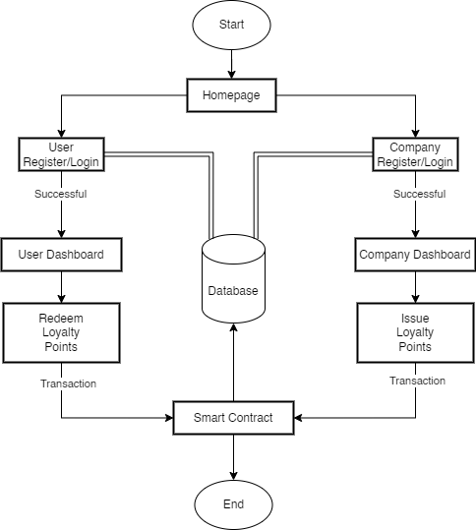
Flowchart

Slide 10
Details of Hardware / Software used
Hardware:
RAM: 16GB
Processor: Latest Generation
Software:
Operating System: Windows/Linux
IDE: Visual Studio Code
Programming Languages: HTML, JavaScript, Python
Libraries/Frameworks: Flask, Web3.py, SQLAlchemy
Browser Extension: MetaMask

Slide 11
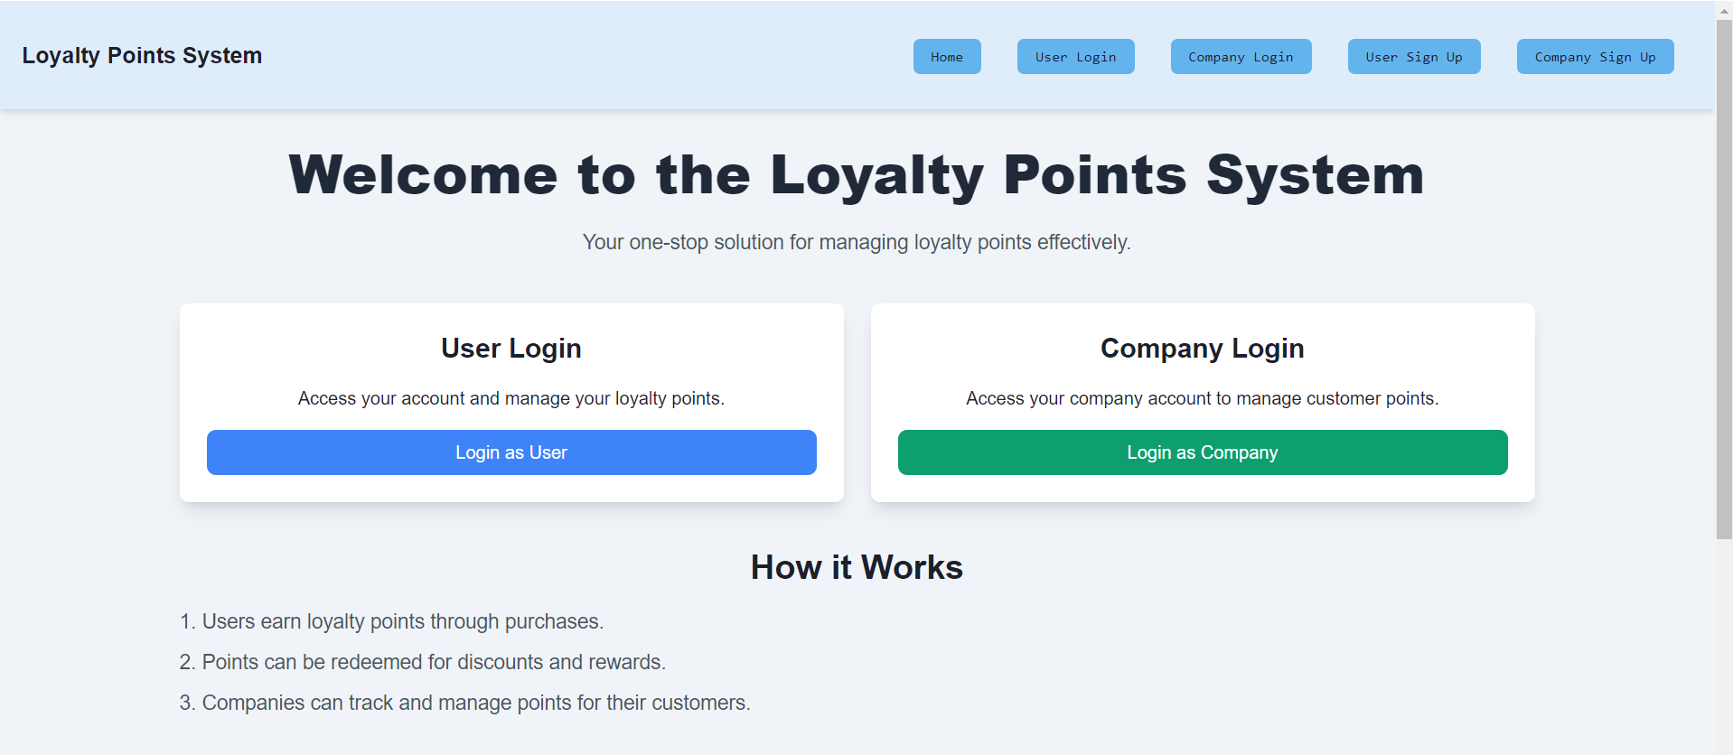
Output

Slide 12
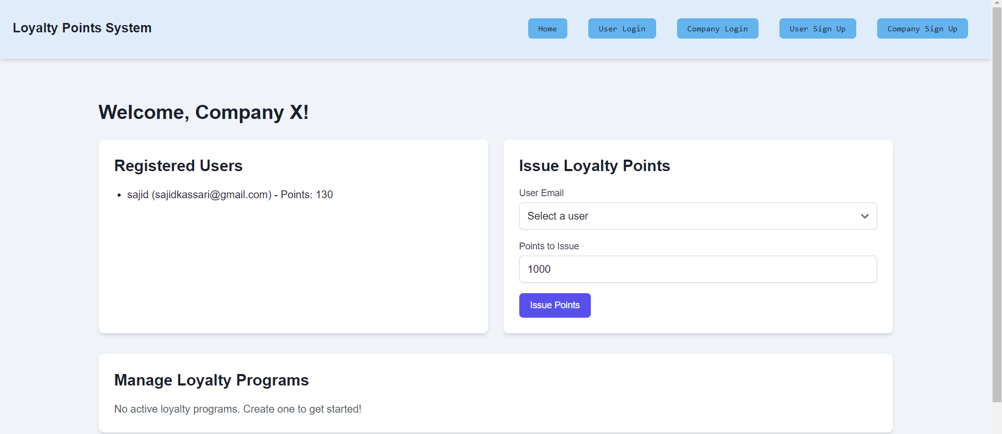

Slide 13
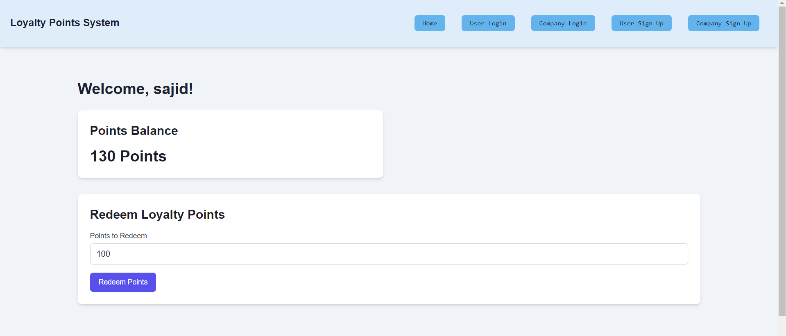

Slide 14
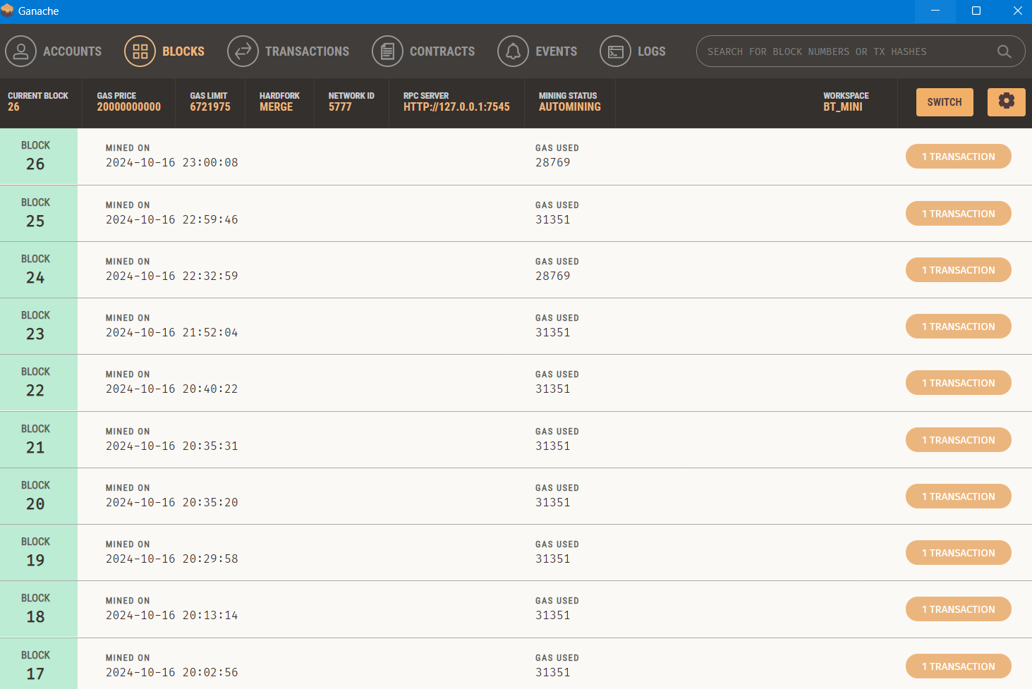

Slide 15
Result analysis
Improved Transparency:
Transactions are recorded on the blockchain, ensuring full transparency and traceability for users and companies.
Increased Efficiency:
Automation through smart contracts significantly reduces manual intervention, cutting down operational costs and time.
Enhanced Security:
Blockchain’s decentralized nature provides robust security, minimizing risks like fraud and unauthorized alterations.

Slide 16
Result analysis
Interoperability:
Users can seamlessly transfer and redeem loyalty points across multiple companies, increasing system flexibility.
User Adoption Challenges:
Initial user adoption can be slow due to the need for familiarization with blockchain-based platforms.

Slide 17
Conclusion
Revolutionizes Loyalty Management: Uses blockchain for enhanced transparency, security, and interoperability.
Decentralized Platform: Automates point issuance, redemption, and transfer via smart contracts.
Increased User Engagement: Early results show improved user trust and interaction.
Challenges: Needs to address user adoption and scalability issues.
Future Enhancements: Plans for gamification and expanded partnerships.

Slide 18
References
[1] Buterin, V. (2014). A Next-Generation Smart Contract and Decentralized Application Platform. Ethereum White Paper.
[2] Kumar, V. & Reinartz, W. (2016). Creating Enduring Customer Value. Harvard Business Review.
[3] Huang, Z., et al. (2020). Blockchain Technology in Loyalty Programs: A Case Study. Journal of Business Research.
[4] Tsiavos, A., et al. (2019). Blockchain Technology and Its Application to Loyalty Programs. International Journal of Information Management.
[5] Mougayar, W. (2016). The Business Blockchain: Promise, Practice, and the Application of the Next Internet. Wiley.

Slide 19
Thank - you

